Slide 1
The Software Testing Pyramid: A Concrete Example
Jim Weaver
Vanderbilt University Medical Center
(weaver.je@gmail.com)
@tenoxtweets
Source Code and Tests
https://github.com/weaverj/testpyramidexample
Selenium tests: Cindy Leffler, VUMC
Notes:
Develop software at hospital - testing is important – critical systems.
Allistair Cockburn, 1999, Methodology per Project - Cockburn scale – criticality and number of people involved. More critical = more publically visible correctness.
2009 Succeeding with Agile, Mike Cohn’s Test Pyramid – helpful concept for us.
We’ll look at implementation for an application, discuss how achieved.
All source and tests available on Github.

Slide 2
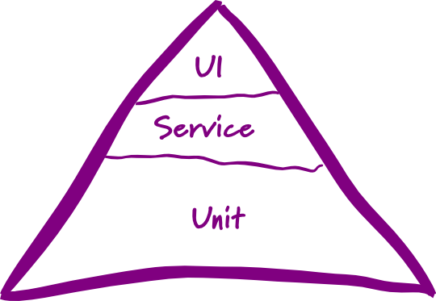
Mike Cohn’s Test Pyramid
Foundational base of unit tests
Minimum necessary tests through user interface
Service tests in the middle
Service refers to logical services – business logic, required outputs to inputs.
Notes:
Follow up article by Cohn – Forgotten Layer of the Test Automation Pyramid regarding service layer – not really referring to SOA.
Google has similar concept for testing – Small, Medium, Large (Unit, Integration, System).
This is just one perspective and vocabulary from which to view tests – there are others (Crispin, Business Facing, Technology Facing, Performance testing, usability testing, etc). Primarily Cohn was discussing tests that verify application functionality.

Slide 3
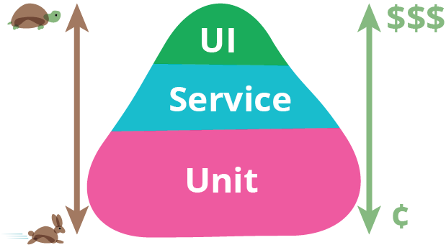
Motivations
Many teams tested primarily through the UI
Testing through UI slower, more brittle, expensive, less precise
Unit tests are easy for developers to write, usually in same language as application, locate bugs more precisely
Service level tests can test logic independent of UI
Notes:
Graphic and discussion from Fowler article, see references.

Slide 4

Challenges
Intentional Planning and Effort
Shared Understanding
Frequent Communication and Collaboration
Notes:
Not accident. What layers of tests, what purpose for those layers, what tools, who authors, at what point in the iteration – all requires planning.
Everyone on team needs to have a common understanding.
Have to collaborate – avoid gaps and excessive duplication.

Slide 5
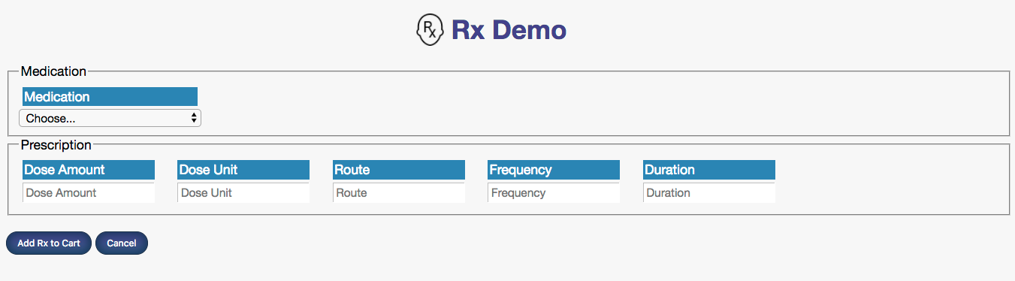
Sample Application : RxDemo
Rx Demo: Web-based Prescribing Application, extracted from real clinical app in production for over a decade.
Notes:
Look at code and test for sample application, how they fit into our intentional testing layers. Based on real prescribing application.
Very small but contains real world feature from real prescribing application
Javascript / static web app with a java back-end service layer

Slide 6
Automated Test Strategy
 | Purpose | Authors | Tools
UI | Test UI functionality, provide some end-end confirmation | QA automation | Junit and WebDriver to Selenium Server
Service | Test business logic, publically verifiable | Customers (including QA) and Developers | Fitnesse
Unit | Test implementation, aid with design and internal code quality | Developers | Junit, Jasmine
Notes:
- Roughly how functionality tests were implemented in the real application.
Fitnesse chosen to provide high visibility (more critical – more publically verifable) of business logic tests to customers, and to drive feature development – tended to be written ahead of assigning feature to developers.
Would discuss with each feature how tests for that feature would fall into these groupings.

Slide 7
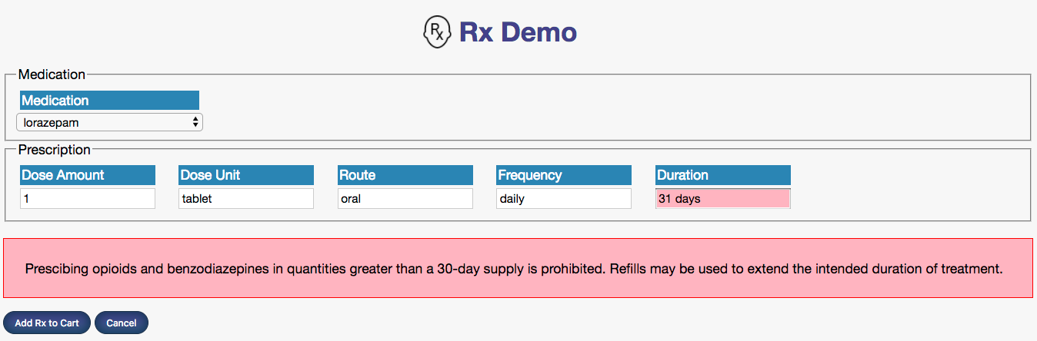
Feature: Limit Opiate Rx Duration
When clinician is prescribing Opiates or Benzodiazepines, limit the duration of the prescription to 30 days or under.
Notes:
To illustrate pyramic-style layer of tests, we’ll look at tests for a particular feature
- What are parts we need to implement?
identify opiates
Calculate number of days from text
apply business rule based on above and inform user

Slide 8

Feature Test Plan
Feature Part | Unit (Junit/Jasmine) | Service (Fitnesse) | UI (Selenium + Junit)
Identify if drug being prescribed is Opiate
Calculate duration
Apply rule to prescription and return response
Inform user in UI if rule violated
Notes:
Notice mini-pyramid shape for just this one feature.
UI-centric tests only needed to test UI behavior, not the business rules for identifying opiates, calculating duration, or applying the rule to a particular perscription.
Intentional, pre-planned distribution of tests for the feature.

Slide 9
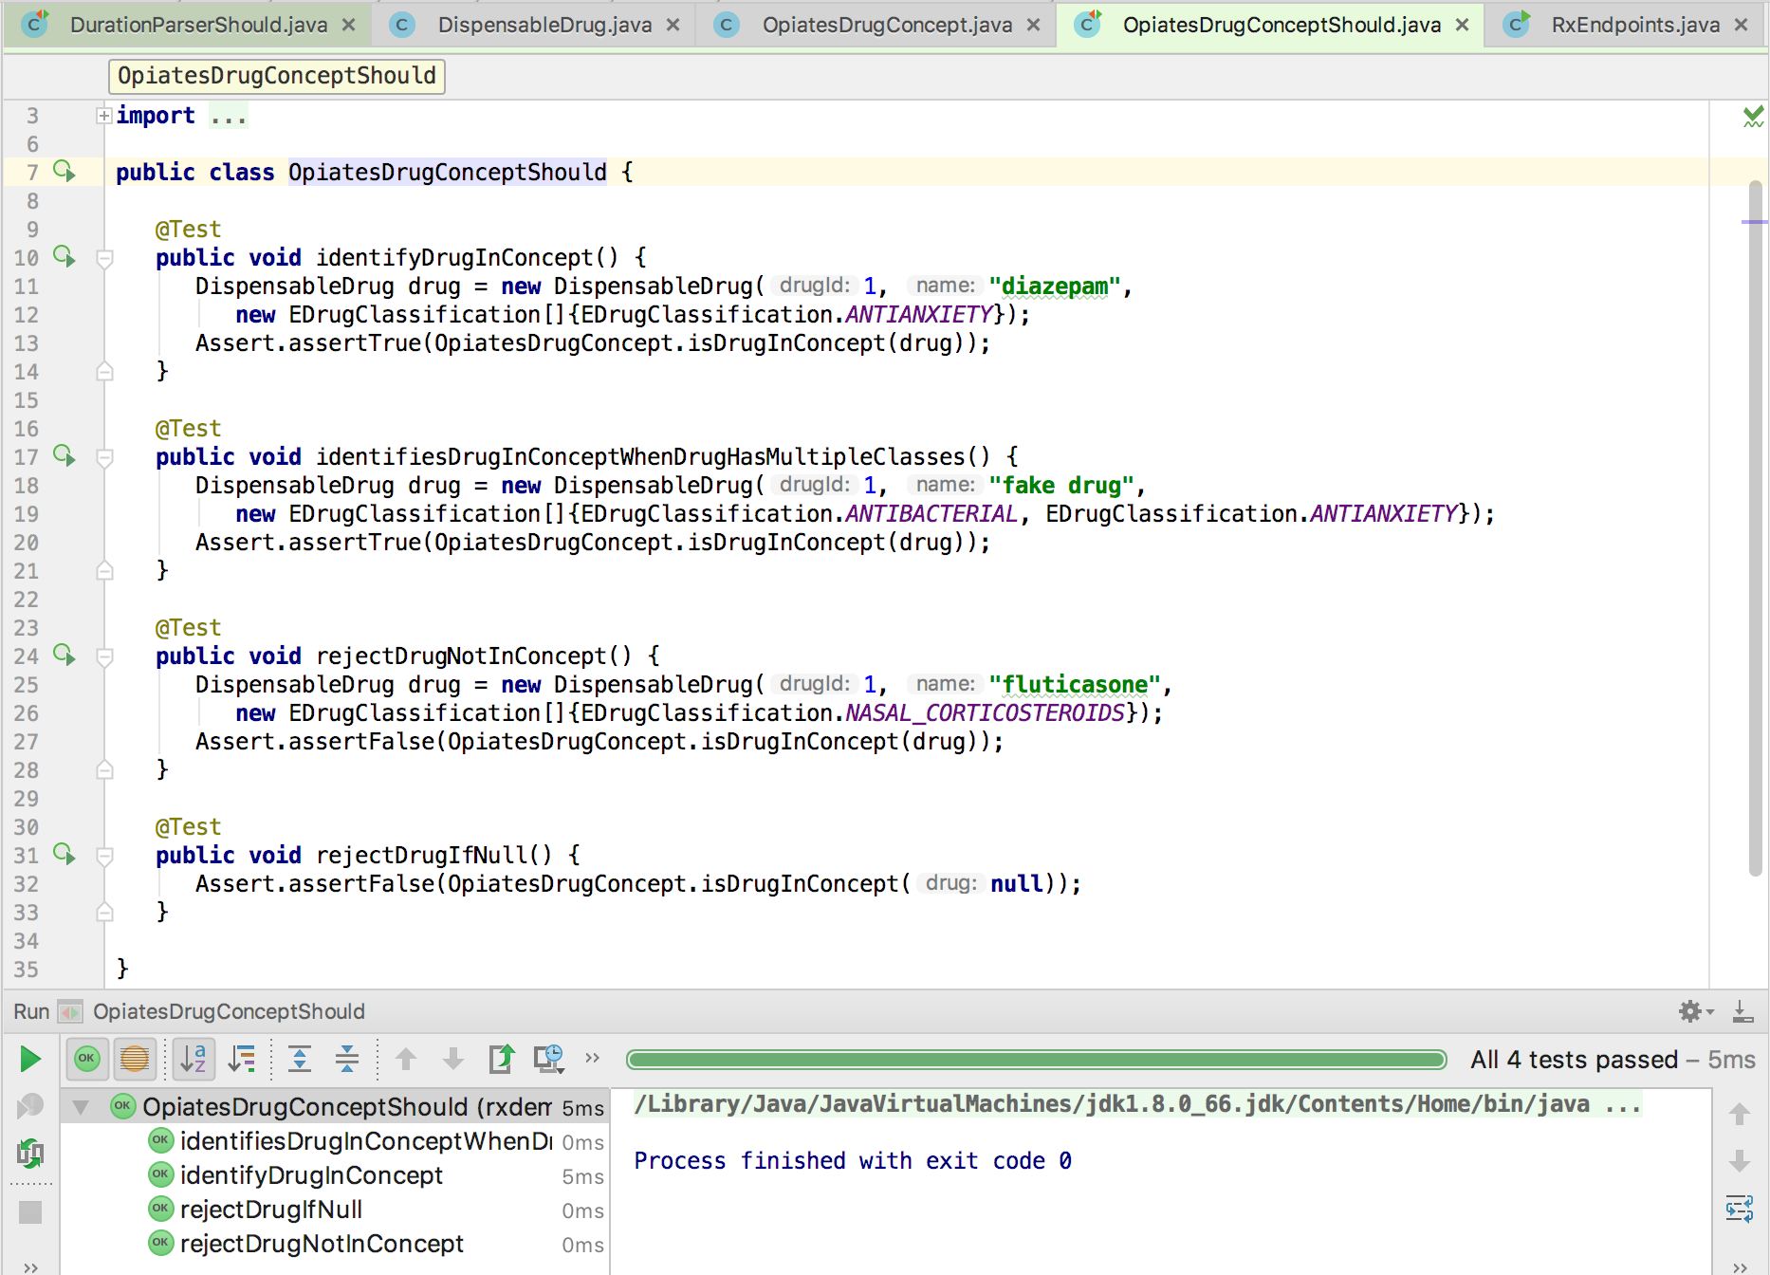
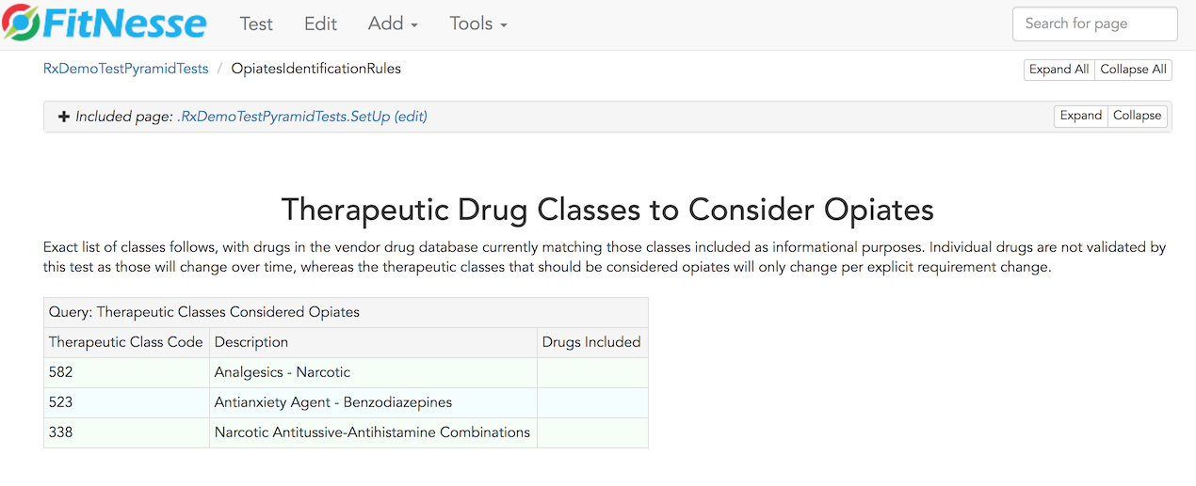
Identify Opiates / Benzos
Feature Part | Unit (Junit/Jasmine) | Service (Fitnesse) | UI (Selenium + Junit)
Identify if drug being prescribed is Opiate
Test source
Test source
Notes:
Fitnesse tests: full spec - each drug classification that should be considered an opiate. Exact match – extra class by code fails, missing class fails.
OpiateDrugConcept is class in our system responsible for this determination, unit tests verify logic of this unit of code without duplicating information in the fitnesse tests.
<Switch to Browser/Fitnesse, Switch to Code>
OpiatesDrugConceptShould states and tests the design of the classes used to determine if a drug is in this class. DispensableDrug, EDrugClassification, and OpiatesDrugConcept classes interact to implement this feature.
Unit test is testing the design and implementation of the units of code supporting this part of the feature, fitnesse is specifying and testing the requirements for this part of the feature. There is little overlap or duplication between the tests for this reason – they complement, not duplicate one another.

Slide 10
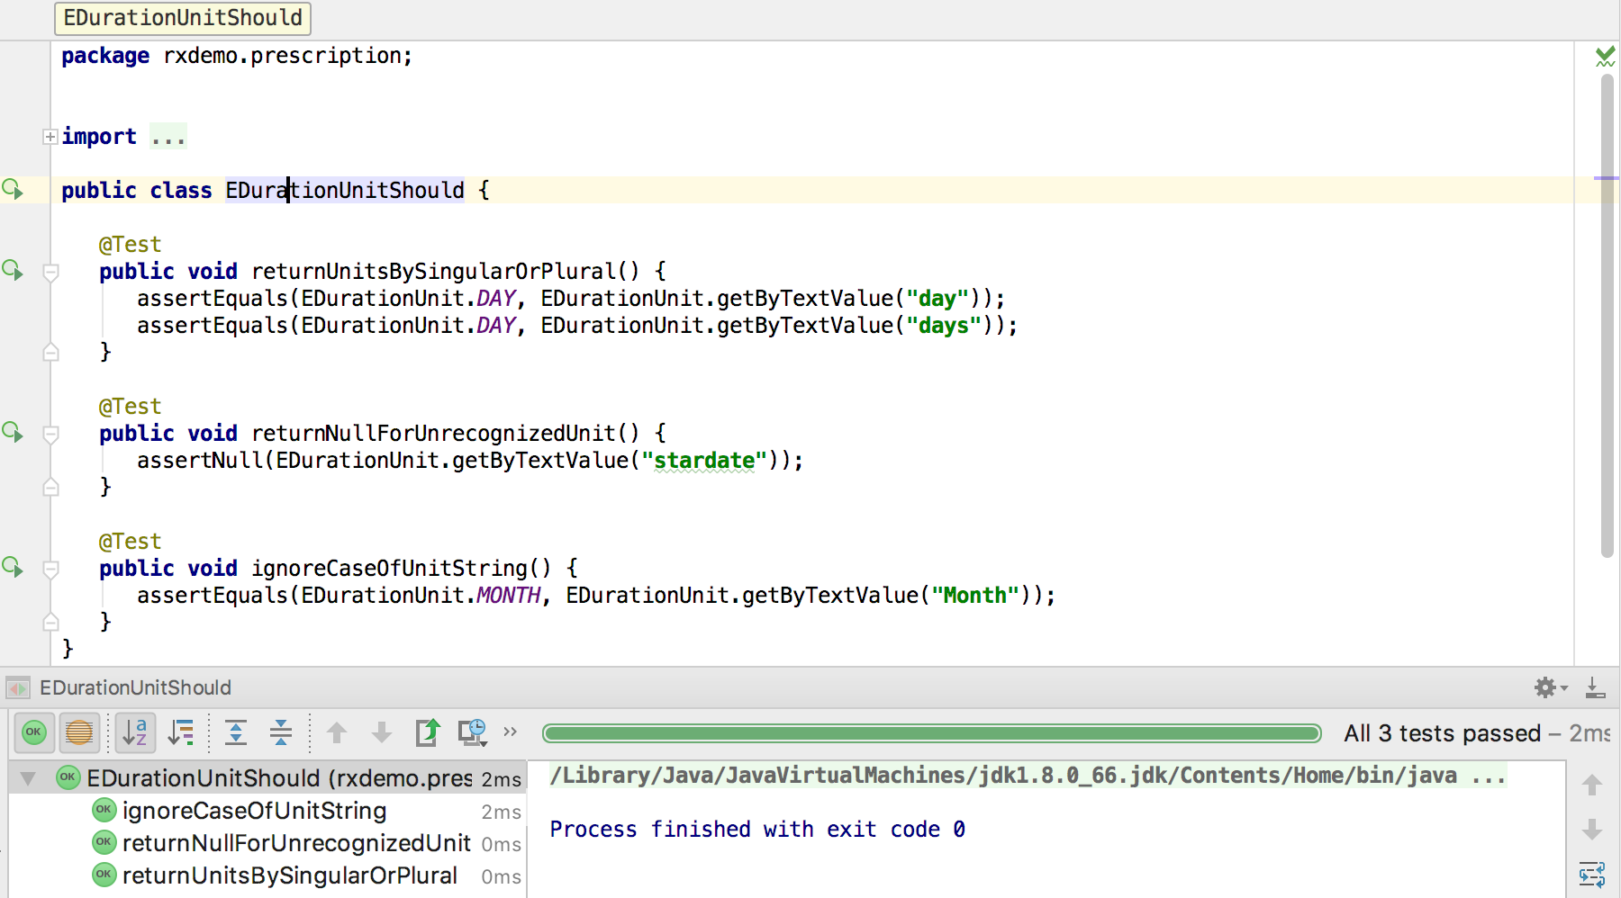
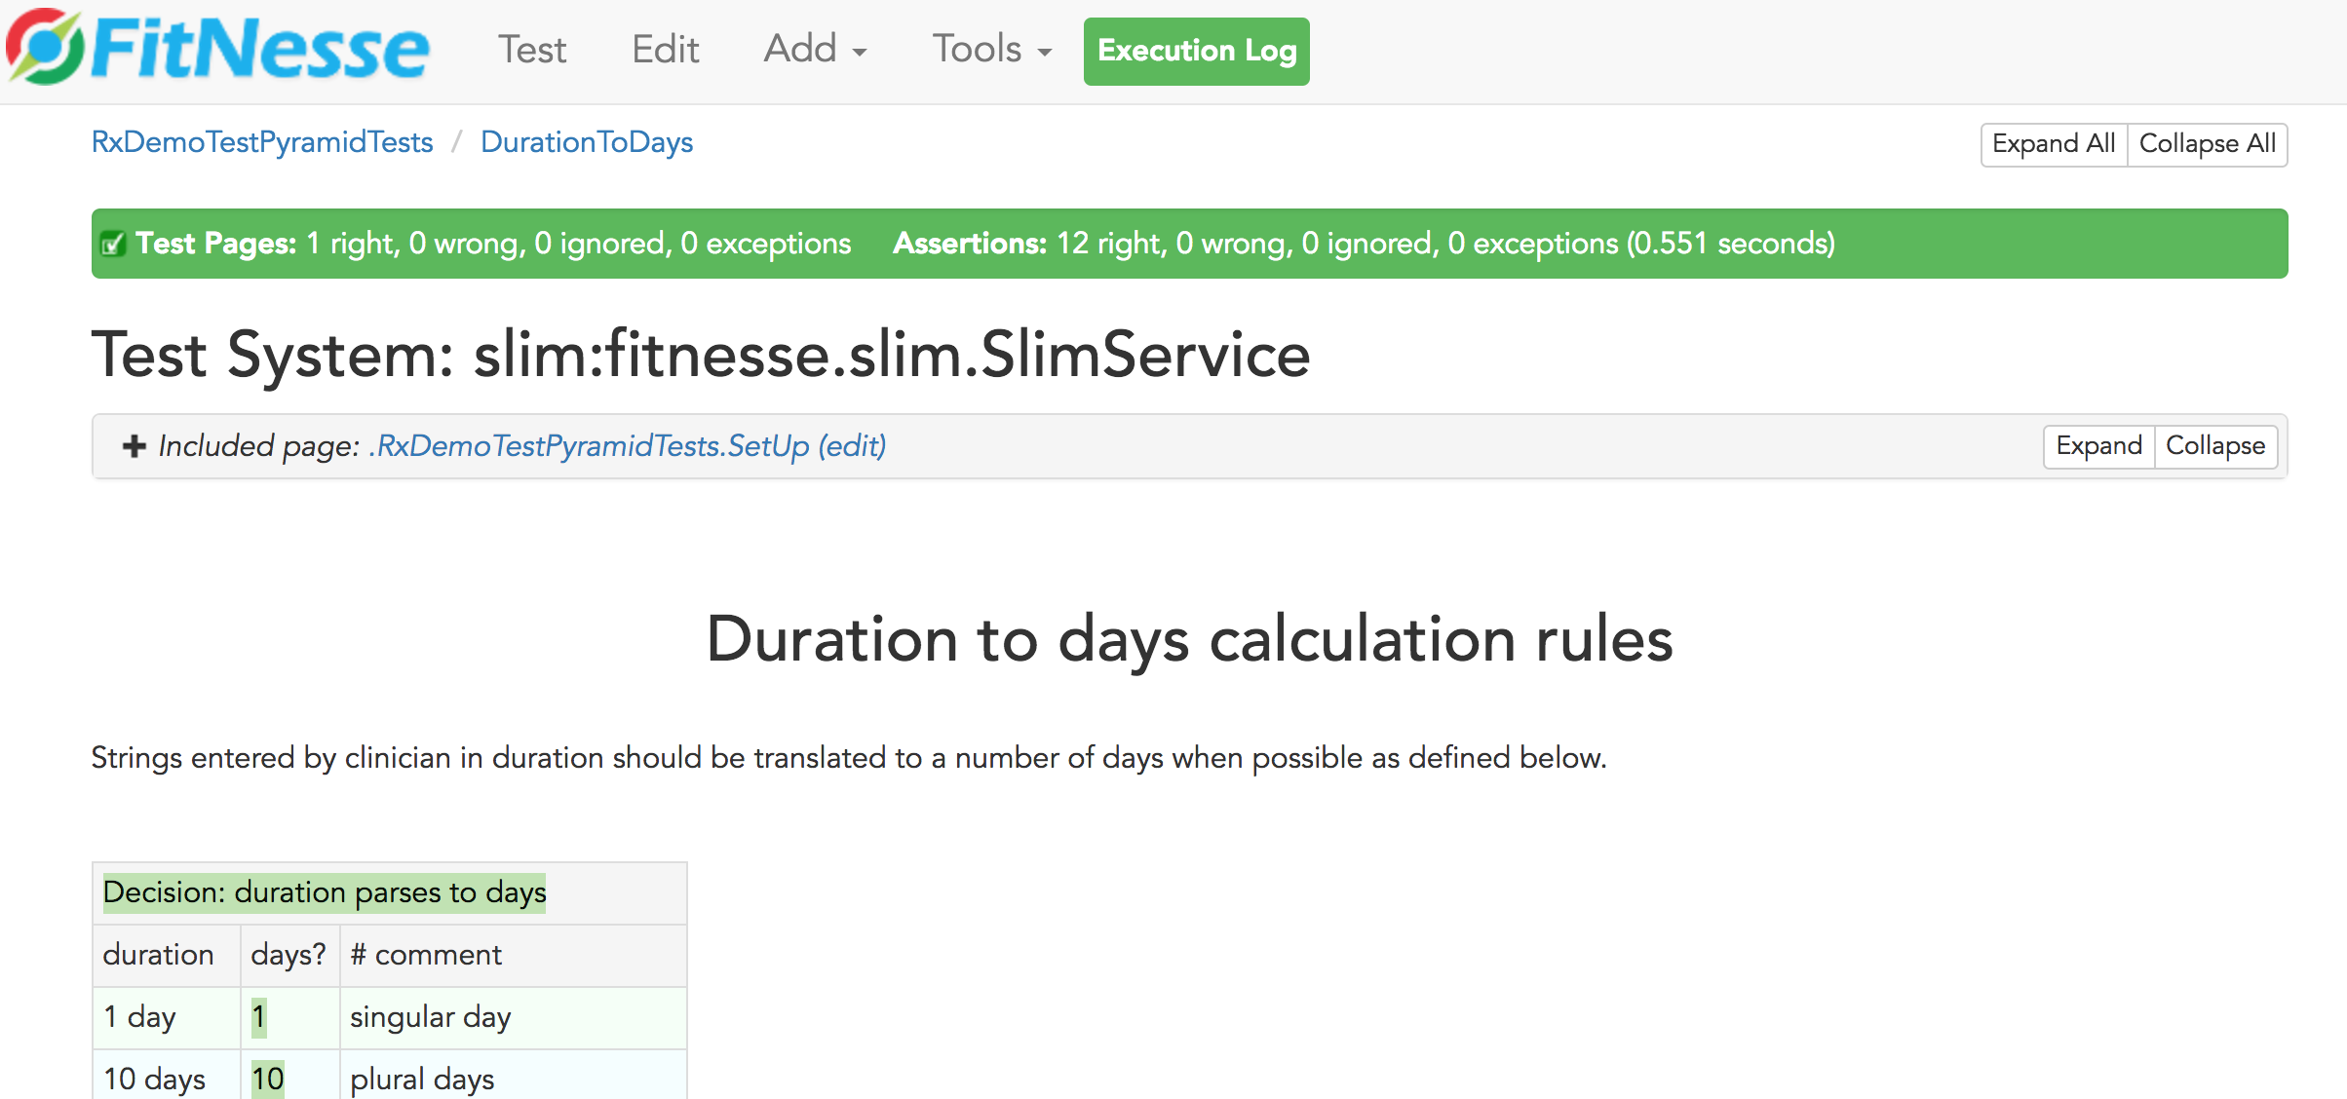
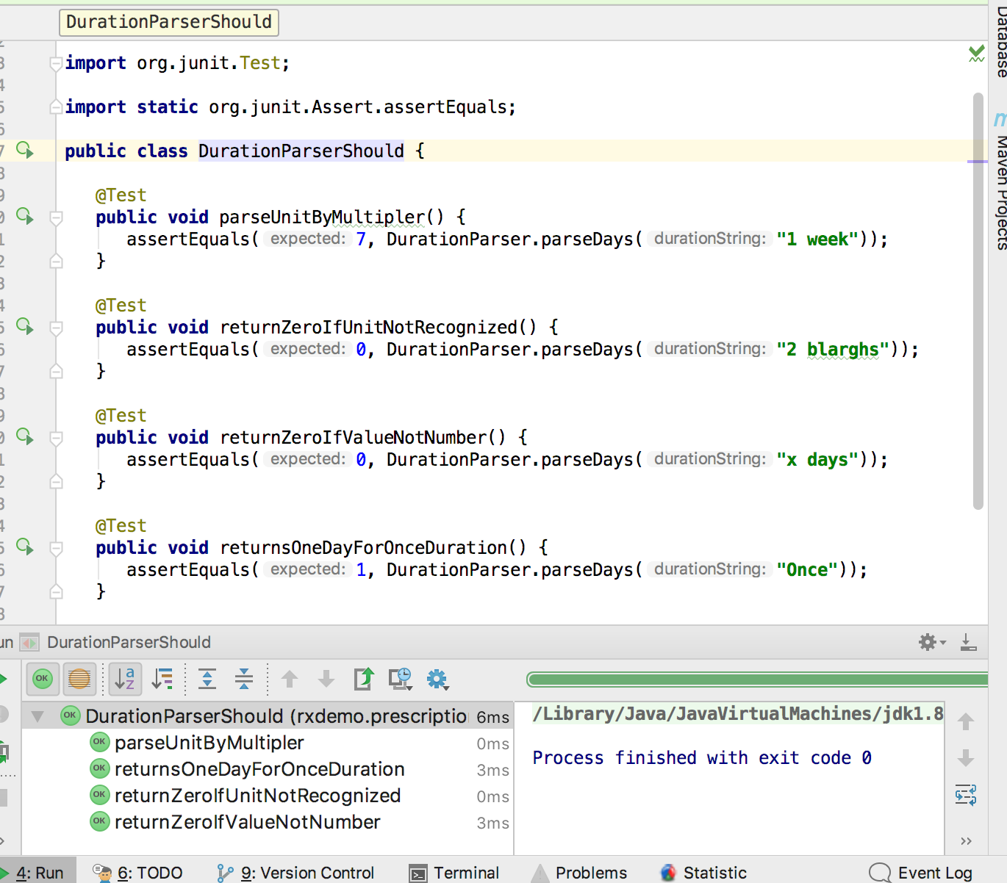
Calculate Duration in Days
Feature Part | Unit (Junit/Jasmine) | Service (Fitnesse) | UI (Selenium + Junit)
Calculate duration
DurationParserShould
DurationToDays
EDurationUnitShould
Notes:
The fitnesse test covers a wide variety of parsing scenarios.
Switch to code
Two classes provide the implementation for this part of the feature, EDurationUnit and EDurationParser. EDurationUnitShould verifies how duration units are expressed and multiplier. The test for EDurationParser covers a few of the duration calculation scenarios covered in the fitnesse test, but not the full range – small amount of overlap.

Slide 11
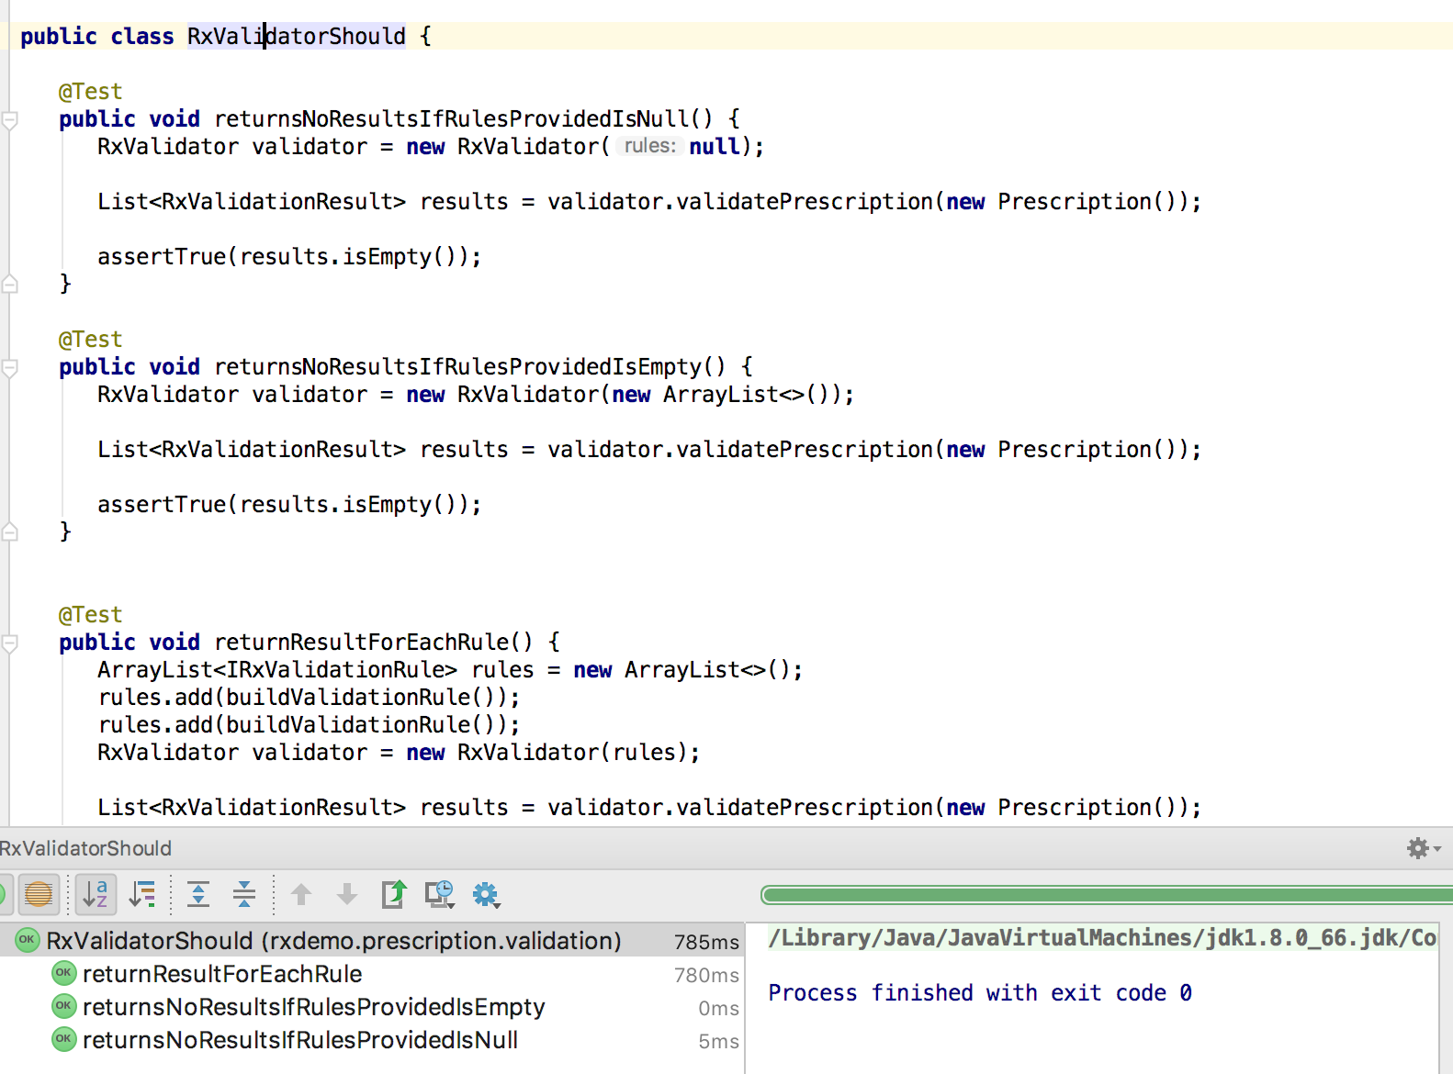
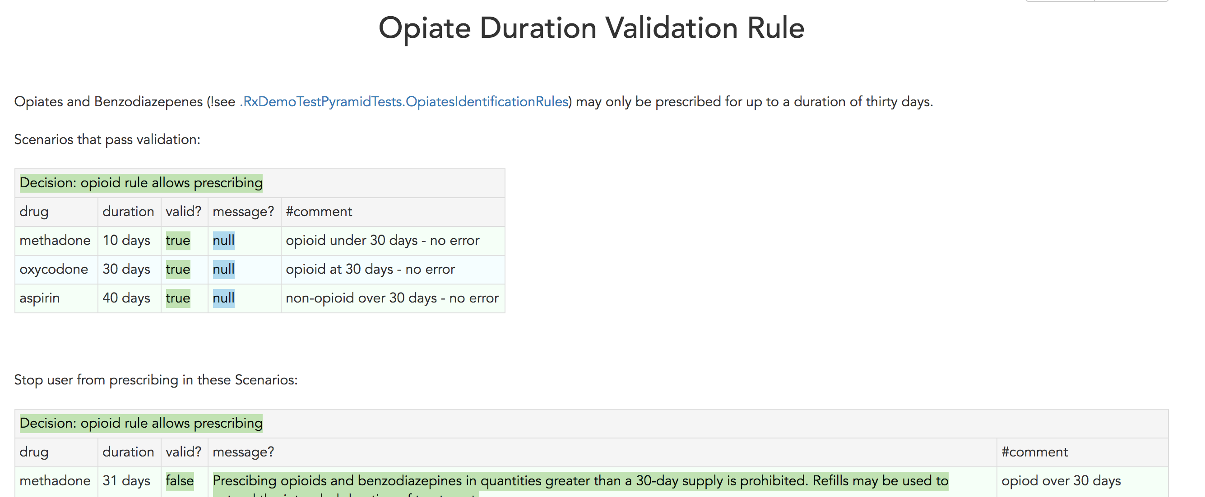
Duration Validation Rule Applied
Feature Part | Unit (Junit/Jasmine) | Service (Fitnesse) | UI
Apply rule to prescription and return response
RxValidatorShould
OpiateDurationRule
OpiateDurationValidationRuleShould
ValidatePrescriptionCommandShould
Notes:
The fitnesse test covers wide range of cases which will both pass and fail the validation rule. It relies on both opiate identification and duration parsing logic.
RxValidator is a class for running multiple validation rules, represented by IRxValidationRule interface, against a prescription. Each rule will return an RxValidationResult that indicates whether the prescription is valid with respect to that rule, and if not what message should be displayed and which prescription fields are related to the failure if any. The RxValidatorShould unit test verifies this rules runner functions correctly, but using fake rules.
ValidatePrescriptionCommand is the initial class invoked to run all prescription validation rules when a prescription is sent from a client browser. It runs all the rules and returns a response to the client. ValidationPrescriptionCommandShould tests this class with fake rules.
OptateDurationValidationRuleShould tests the validation rule used for this feature. It tests a few scenarios, including edge case like a null drug, but does not cover all business scenarios as they are covered by fitnesse test.

Slide 12
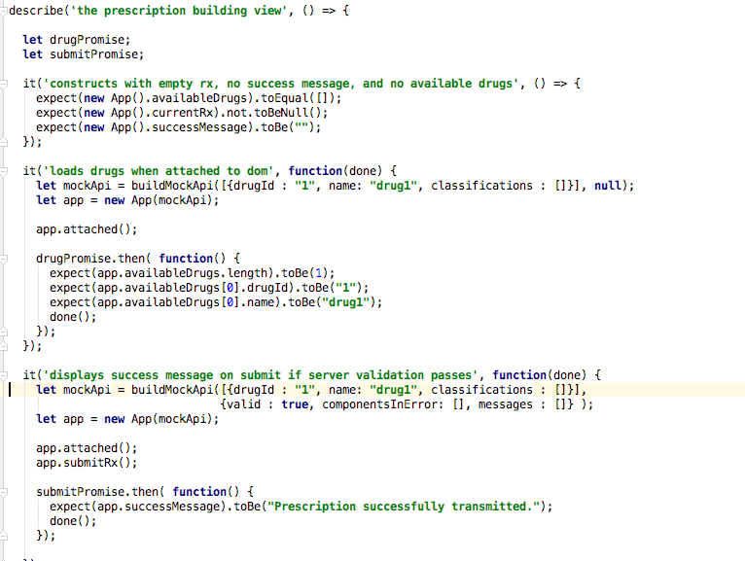
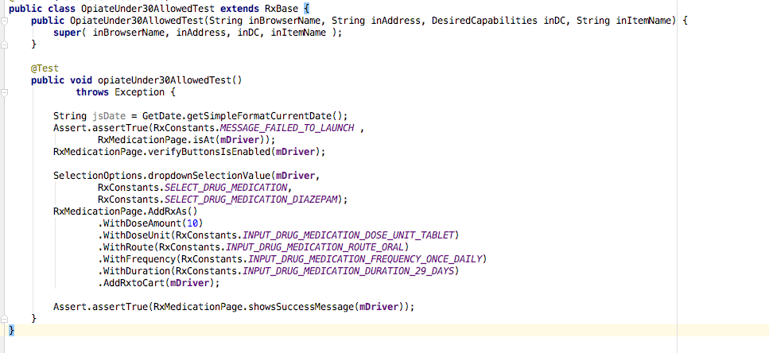
Inform User in UI if Rule Violated
Feature Part | Unit (Junit/Jasmine) | Service (Fitnesse) | UI (Selenium / Junit)
Inform user in UI if rule violated |  |  | OpiateUnder30Allowed OpiateOver30NotAllowed
RxValidatorShould
App.spec.js
RxValidationResponseHandler.spec.js
Notes:
Just two cases covered in Selenium that verify UI displays correct state when it is supposed to display a message, and when it is not.
Jasmine unit tests verify app controller state is correct based on successful and failed validation JSON responses, fields marked in error correctly
Some duplication here / success state and failure state on controller – this is also verified by Selenium tests. But the unit tests are specific to the controller code – failure of the Selenium tests could be less precise.
What if we were testing entirely through the UI? All of these scenarios covered in fitnesse and unit tests would need to be managed through UI tests – all the duration calculation scenarios, every opiate drug identified correctly, how to verify drugs aren’t included accidentally as opiates – prescribe every single possible drug?

Slide 13
Team Process and Habits
Discuss application-wide testing strategy – layers of tests, their purpose, tools, team-member responsibilities.
Keep all team members involved in all types of tests.
For each feature, explicitly discuss a test plan – what automated tests will there be at what levels?
Watch for unwanted duplication or gaps in test coverage.
When a bug hits production, don’t just fix it - find the test gaps and close them.
Notes:
Specific activities that helped achieve healthy pyramidal mix of tests for the real prescribing app.

Slide 14
References
Succeeding with Agile: Software Development Using Scrum by Mike Cohn, Addison-Wesley, 2009
The Forgotten Layer of the Test Automation Pyramid: Mike Cohn, 2009.
TestPyramid: Martin Fowler, 2012.
Small, Medium, Large: Mike Bland, 2011.
Methodology Per Project: Alistair Cockburn, 1999.

Slide 15

Questions?

